Slide 1
Английский язык
Подготовка к устной части ЕГЭ
Опыт работы учителя английского языка МБОУ «СШ №1» г. Десногорска Степанченко Н.Н.

Slide 4
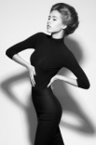
Students- студенты
Smile - улыбаться
Click- щелкать
Mouse- мышь
Play - играть
Computer- компьютер
Camera- фотокамера
Pose -позировать

Slide 5
students | are [ а ] | smile | + ing
students | are [ а ] | click | + ing
students | are [ а ] | play | + ing | on
students | are [ а ] | not pose | + ing | before [биˈфО]

Slide 6
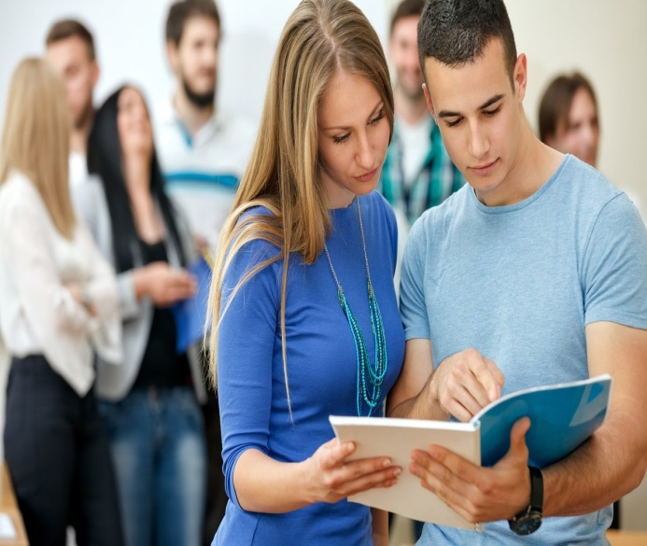
Task 3
These are photos from your photo album. Choose one photo to describe to your friend.
You will have to start speaking in 1.5 minutes and will speak for not more than 2 minutes (12–15 sentences). In your talk remember to speak about:
● where and when the photo was taken (где и когда сделана фотография) ● what/who is in the photo (кто на фотографии) ● what is happening (что происходит на фотографии) !!! ● why you keep the photo in your album (почему Вы храните фото в вашем альбоме) ● why you decided to show the picture to your friend (почему Вы решили показать фотографию вашему другу)
You have to talk continuously, starting with: “I’ve chosen photo number …”
К Вам пришёл Ваш друг, и Вы решили показать ему свой фотоальбом. Вы выбираете одну фотографию и рассказываете ему о ней.

Slide 7
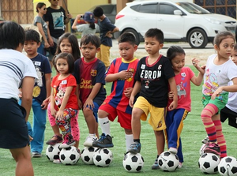
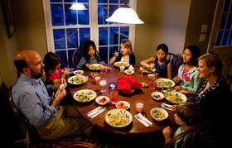
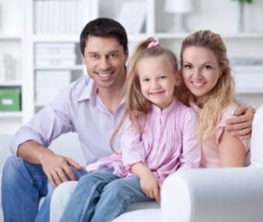
Описание картинки
I have chosen photo number…
I took this photo in the (village,city,..) last summer
The weather was (nice, bad)
I took a lot of photos that day
In this photo you can see…
Если люди, то:
She (he,they) is(are) (not) posing before the camera
She (he,they) is (are) smiling…
She (he,they) is (are) wearing…
She (he,they) is (are) doing smth.
In the background there is (are).., (who)…
You can also see … on the left/ right.
Если природа, то:
The Sun is (not) shining..
The wind is(not) blowing
There are (not) clouds in the sky
They are reflecting in the (lake, water..)
I keep this photo in my album in order to memorize this day
I decided to show this photo to my friend because she (he) is my close friend and…
Besides, the photo is worth a thousand words
.

Slide 8
I have chosen photo number 3
(я выбрал фото №3)
I took this photo in the city last week
(я сделал это фото в городе на прошлой неделе)
I took a lot of photos that day
(я сделал много фото в тот день)
In this photo you can see a group of students
(на этом фото Вы видите группу студентов)
The students are not posing before the camera
(студенты не позируют перед фотокамерой)
They are smiling
(они улыбаются)
They are playing on the computer
They are wearing shirts and T-shirts
(на них рубашки и футболки)
In the background there are other computers
(на заднем плане есть и другие компьютеры)
I keep this photo in my album in order to memorize this day
(я храню это фото, чтобы помнить этот день)
I decided to show this photo to my friend because he is my close friend and he knows these people.
(я решил показать это фото моему другу, потому что он мой близкий друг и он знает этих людей)

Slide 9
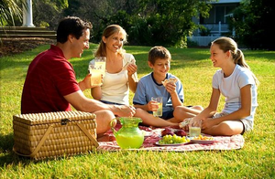
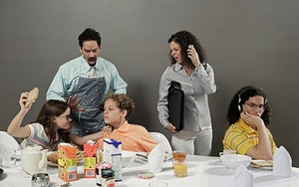
Сравнение картинок
I’d like to compare and contrast these two pictures
These pictures are about…
In the first picture we can see…
In the second photo there is…
There are some similarities between these two pictures…
I think that what unites them is that in both pictures we can see…
Besides…
There are more differences than similarities between these two pictures…
I’ll name some of them
Firstly, the first picture shows…
While, the second one depicts…
Secondly,… whereas…
But the most striking difference is…
Personally, I’d prefer…because.. (назвать причины)

Slide 10
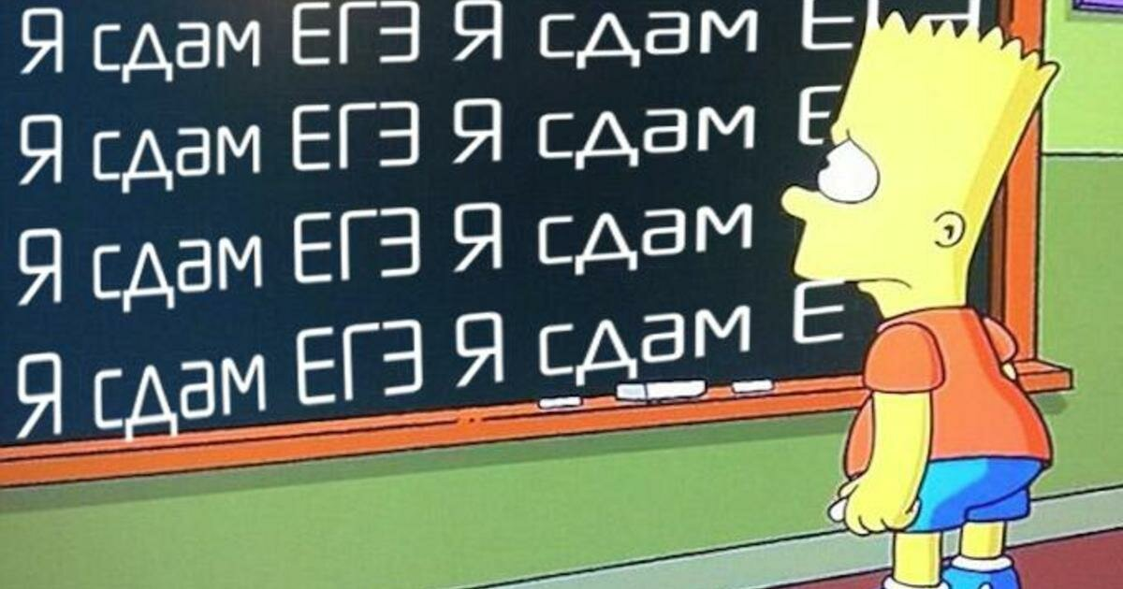
english exam
-no problem

